Slide 1
Financial Loan Project
Tools Used: MySQL | Excel | Python

Slide 2
Agenda
Introduction & Objectives
MySQL Queries
Dashboards: Excel
Python Visualization
Conclusion
Inferences
Challenges & Solutions

Slide 3
Introduction & Objectives
Introduction:
The Bank Loan Report is a strategic initiative designed to monitor, evaluate, and visualize the performance of lending operations across key dimensions.
By combining detailed KPIs with interactive dashboards, it empowers stakeholders to make informed decisions, optimize lending strategies, and access portfolio banking with precision.
Objectives:
Build dashboards in Excel and Monitor key loan metrics with MTD and MoM comparisons.
Classify and evaluate Good vs Bad loan performance.
Visualize trends by time, region, and borrower attributes.

Slide 4
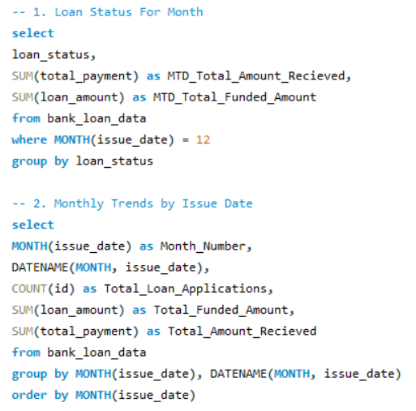
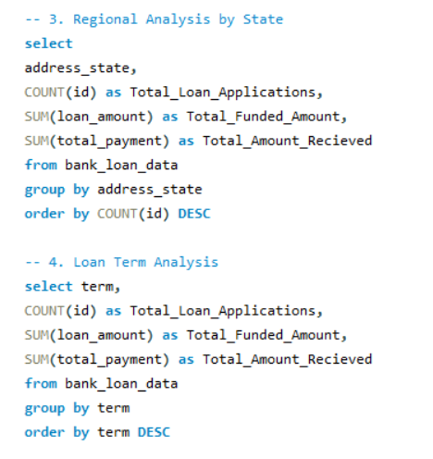
MySQL Queries

Slide 5
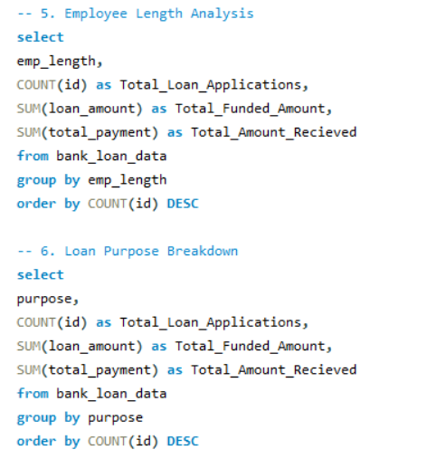
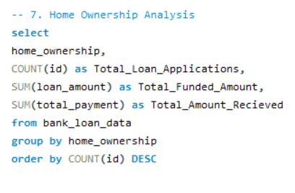
MySQL Queries

Slide 6
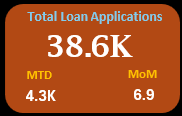
KPI 1 – Total Loan Applications
Volume of Business: The bank has received a substantial 38,600 loan applications, indicating strong market demand for its credit products.
Operational Scale: This high volume reflects the significant workload handled by the application intake and initial underwriting teams.
Funnel Foundation: These 38.6K applications represent the total pool from which all funded loans and subsequent revenue are generated.
Growth Tracking: This figure serves as a key baseline metric to track the bank's growth in customer acquisition over time.

Slide 7
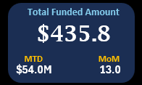
KPI 2 – Total Funded Amount
Capital Deployment: The bank has deployed a significant $435.8 million in capital, building a substantial loan asset portfolio.
Primary Risk Exposure: This entire amount represents the total outstanding principal and the bank's main exposure to borrower credit risk.
Revenue Generation Base: This $435.8 million is the principal base upon which all interest income, the bank's primary earnings from lending, is calculated.
Portfolio Size Indicator: This figure is a direct measure of the scale and size of the bank's lending business.

Slide 8
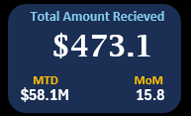
KPI 3 – Total Amount Recevied
Cash Flow Indicator: The bank has successfully collected $473.1 million, which is crucial for its liquidity and ability to fund new loans and operations.
Portfolio Performance: The fact that the amount received is higher than the total funded amount indicates that the overall portfolio is generating positive cash flow.
Collections Efficiency: This high value demonstrates the effectiveness of the bank's collections department and the general creditworthiness of its borrowers.
Profitability Source: A significant portion of this inflow is interest income, directly contributing to the bank's net profit.

Slide 9
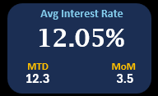
KPI 4 – Average Interest Rate
Pricing Strategy Outcome: The 12.05% average reflects the bank's successful balance between offering competitive rates and maintaining profitability.
Income Yield: This rate directly determines the yield or return the bank earns on its $435.8 million funded amount.
Risk-Price Alignment: The rate is set based on the overall risk profile of the borrower pool, ensuring the bank is compensated for the credit risk it undertakes.
Market Competitiveness: This average must be monitored against competitors and market benchmarks to ensure the bank's products remain attractive.

Slide 10
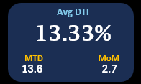
KPI 5 – Average DTI
Overall Borrower Health: The average DTI across the portfolio is 13.33%, which is considered very low and indicates that borrowers, on average, have a comfortable amount of income relative to their debt obligations.
Low Risk Profile: A DTI of 13.33% is significantly below common warning thresholds (e.g., 36-43%), signaling a low-risk loan portfolio with a strong capacity for borrowers to repay their debts.
Positive Trend: The Month-over-Month (MoM) change is +2.7%, showing a slight increase. This needs monitoring, but the ratio remains exceptionally low, so the risk level is still very favorable.
Underwriting Benchmark: This figure validates the bank's lending standards, showing that it has successfully selected borrowers who are not over-leveraged, contributing to the high "Good Loan" percentage in the overall portfolio.

Slide 11
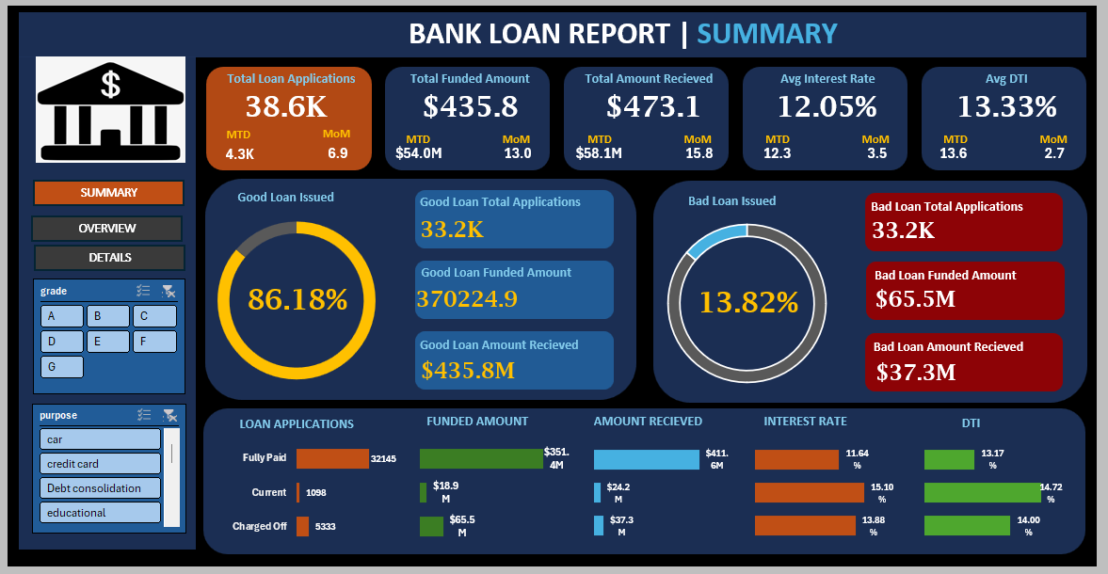
Summary Dashboard – Excel

Slide 12
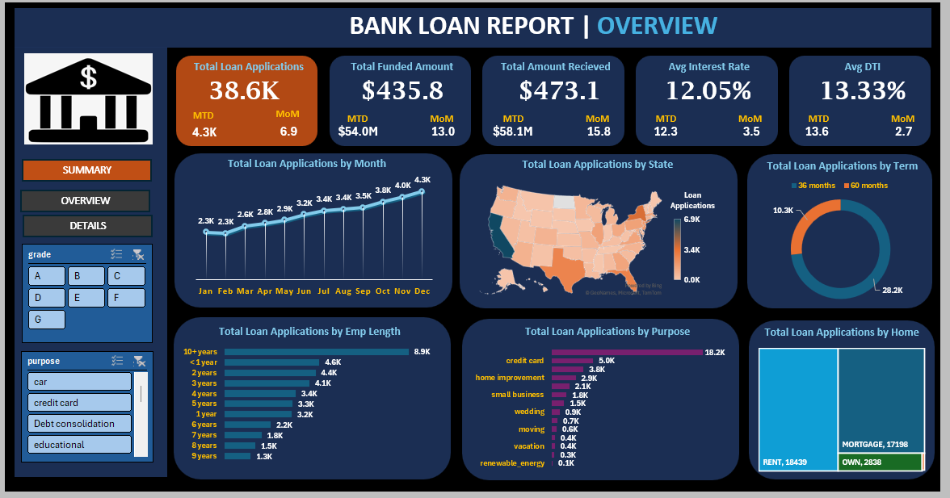
Overview Dashboard – Excel

Slide 13
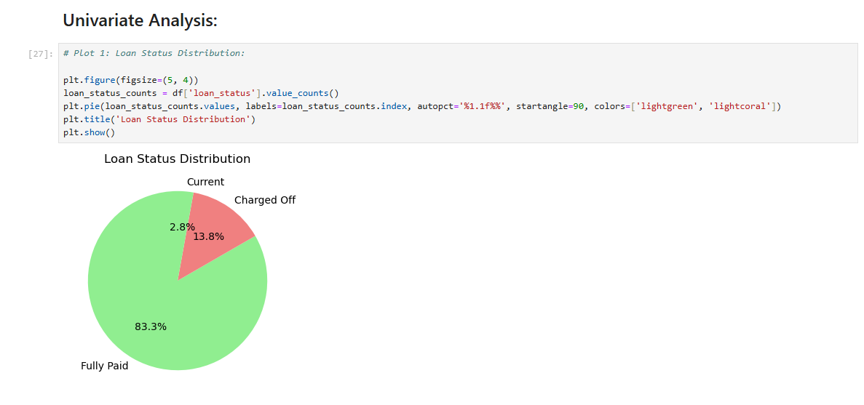
Univariate Analysis – Python

Slide 14
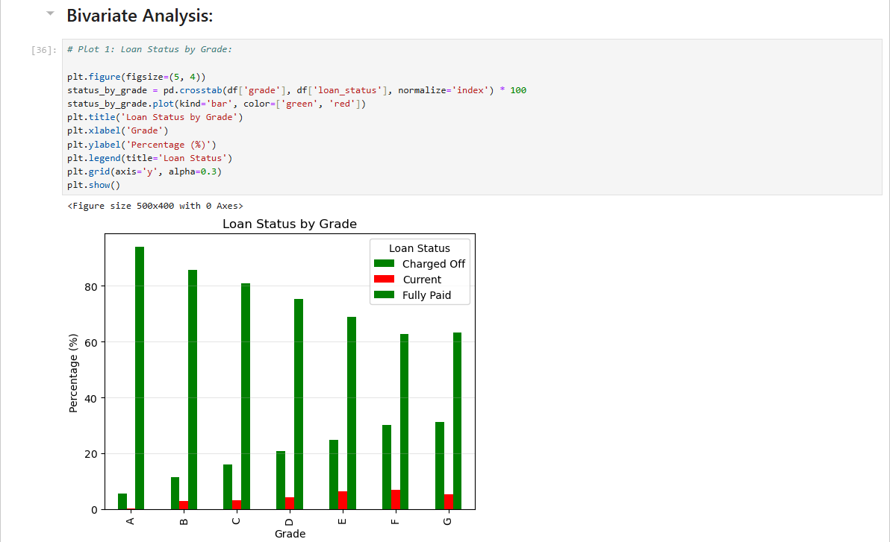
Bivariate Analysis – Python

Slide 15
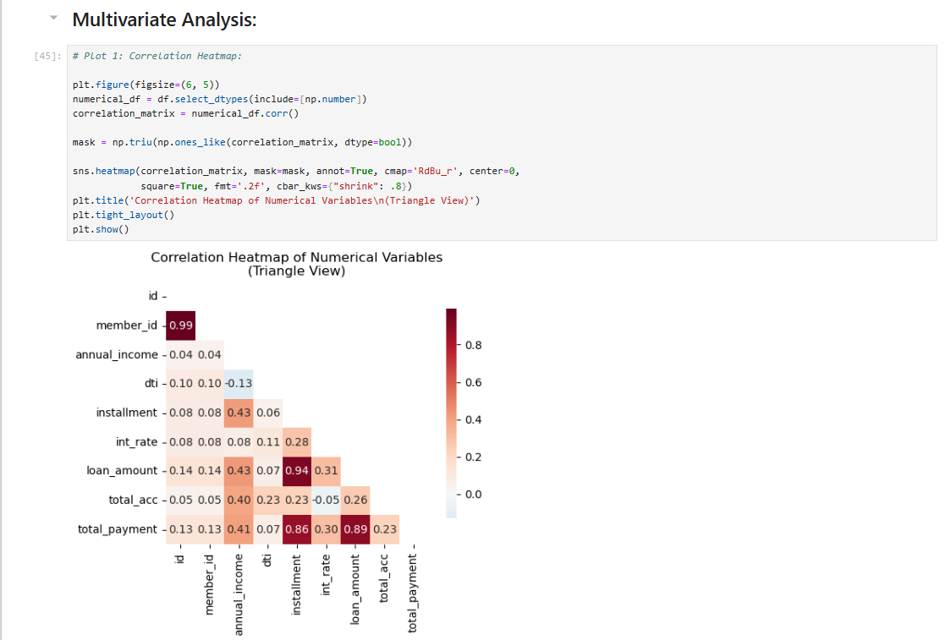
Multivariate Analysis – Python

Slide 16
Conclusion
Used SQL to extract, filter, and aggregate loan data from structured sources.
Built interactive Excel dashboards to visualize KPIs and summarize loan performance.
Applied Python for data cleaning, transformation, and exploratory data analysis (EDA).
Conducted univariate, bivariate, and multivariate analysis to uncover key patterns and relationships.
Segmented loans into Good vs Bad categories for portfolio quality assessment.
Analysed monthly trends and regional lending patterns using dynamic visualizations.
Explored loan behaviour by term, purpose, employment length, and home ownership.
Calculated MTD and MoM metrics for applications, funding, repayments, and borrower health.
Created a Loan Status Grid View to compare performance across different loan statuses.
Delivered a comprehensive, data-driven report to support strategic lending decisions.

Slide 17
Inferences
Good loans dominate the portfolio, with a higher percentage of applications marked as 'Fully Paid' or 'Current', indicating strong repayment behaviour.
Charged-off loans show lower recovery, with significantly less received amount compared to their funded value, highlighting risk in certain borrower segments.
Loan purpose and employment length impact performance, with debt consolidation and longer employment histories correlating with better repayment outcomes.
Regional disparities exist, as some states consistently show higher application volumes and funded amounts, suggesting localized lending demand.
Higher DTI ratios align with bad loan status, indicating that borrower financial stress may be a key predictor of loan default.

Slide 18
Challenges Faced & Solution
Challenges:
  Data Quality Issues: Missing values, inconsistent formats, and outliers made initial analysis difficult.
  Schema Mismatch During Import: Errors occurred while importing CSV into SQL Server due to data type mismatches or column length issues.
  Complexity in KPI Calculations: Deriving MTD, MoM, and segmented loan metrics required careful filtering and aggregation logic.
Solutions:
  Performed Data Cleaning in Python: Used Pandas to handle nulls, standardize formats, and detect outliers before analysis.
  Adjusted SQL Table Schemas: Modified column data types and lengths to match the CSV structure, ensuring smooth data import.
  Modularized KPI Logic: Broke down complex calculations into reusable SQL queries and Python functions for clarity and accuracy.

Slide 19
Thank You!

